Slide 1
medCafe Overview
Gail Hamilton and Jeff Hoyt
703-983-7855 • ghamilton@mitre.org
703-983-6241 • jchoyt@mitre.org
703-983-7043 • mgreer@mitre.org
MITRE Internal Information
For Limited External Release

Slide 2
MedCafe : Why Did We Do It?
Current VA Physician workflow not optimal
Streamline workflow through timelier data re-acquisition
Provide functionality to deal with physician ‘pain points’
Allow Physician rapid access to most pertinent data first
Design more intuitive interface modeling how physician would want to access data
We want to demonstrate ways to give
caregivers more time to do what matters most
Notes:
About 2 years ago, we were talking about some of the challenges CMS was facing with their medical records and realized that the work we were doing on CCOD would go a great way towards addressing those problems. We submitted a MIP proposal and that's when we found Dr. Christian Donahue (through Chris Spirito)and what we discovered was that the VA was facing similar issues (go to "current VA workflow" slide).

Slide 3
MedCafe Objectives
Goal was to explore ways to deal with EHR frustrations
Multiple data sources
“one size fits all” UI
Outside records/images
Etc.
We built a prototype to explore these issues
Web based (fully web 2.0)
Extensible architecture
CCoD¹ principles
Allow for Best of Breed
Listened to SMEs (Dr. Donohue)
¹Composable Capability on Demand
Notes:
Multiple Data sources. No standard – too many standards
EHRs don’t communicate seamlessly
One size – different people, different roles, need to see different aspects of patient health record. And each patient will have specific data and unique information.
No way to highlight what is important.
Outside Records: Dr estimates 80% workload is taken dealing with these records
Uncategorized scanned in pdfs. Generally labeled with radiologist name. No real way to distinguiush what it shows without looking at it.
And many more issues….

Slide 4
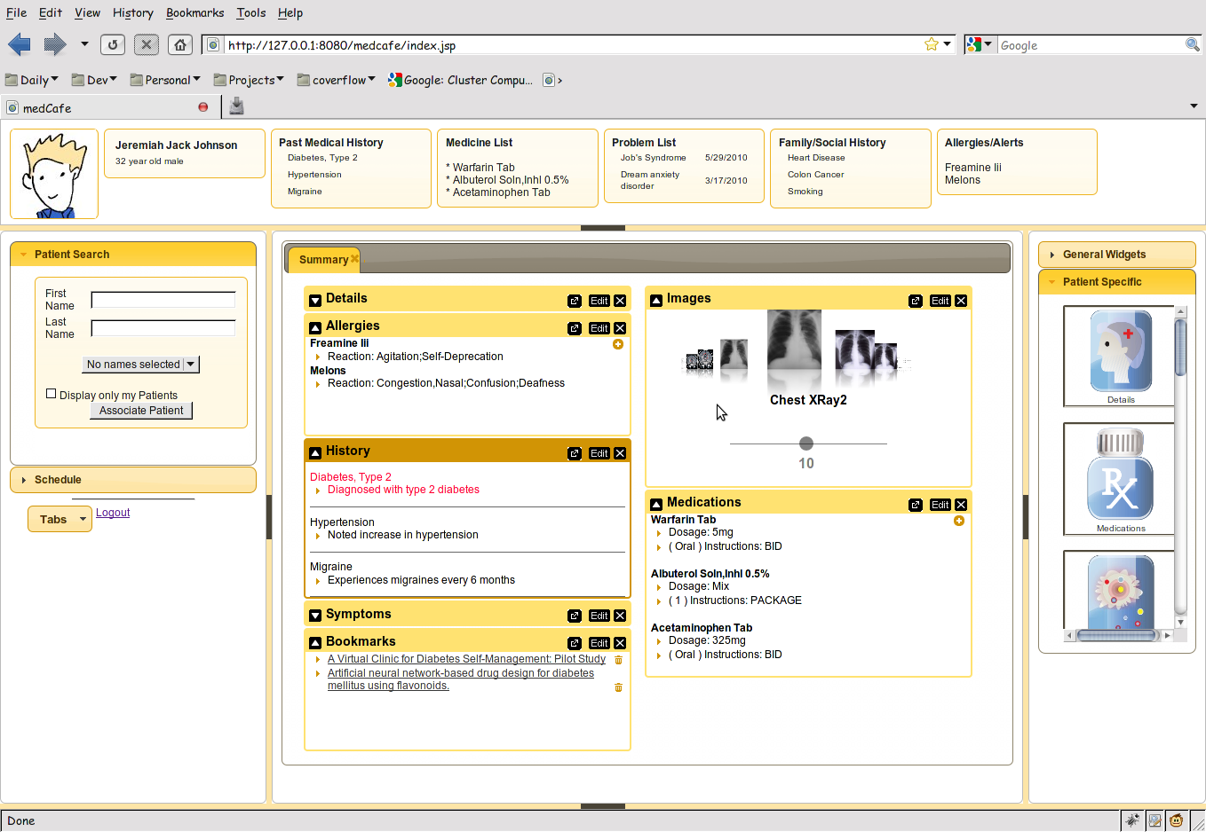
medCafe Interface
Notes:
Framework overview:
5 major panes, North, South, etc,..
Can hide, show each pane.
Each pane can have multiple objects within it, such as tabs, widgets, sliders,treeviews etc,..

Slide 5
Project Development Milestones
Coverflow
Image Viewer
Date slider
Charts
Tables
Tree View
Image Zoom
Charts
Patient Data
Allergies
Medications
Sortable
Collapsable
Save state of patient data so physician can return on login
Security – login page
Patient search / selector
Scheduling
Drag and drop functionality
Introductory page directing user to select patient
Recent patient list
Multiple Repositories
Coversheet Header
Add additional data-sources: hData
PDF Text extraction of discharge summaries
Categorizing the data
Tooltip for more details
Fuzzy matching on categories (e.g. Smoker/ Smoking)
Timeline showing events, office visits etc,
Clickable to bring up associated chart/ Xray
Text editor with templates
Copy text between widgets
Filter on categories
Medication List
Allergy List
Multiple widgets per tab
Customizable look and feel
Patient “Dashboard”
Patient photos
Mobile device compatibility (iPad)
Categorize the data
Save state of patient data so physician can return on login
Security – login page

Slide 6
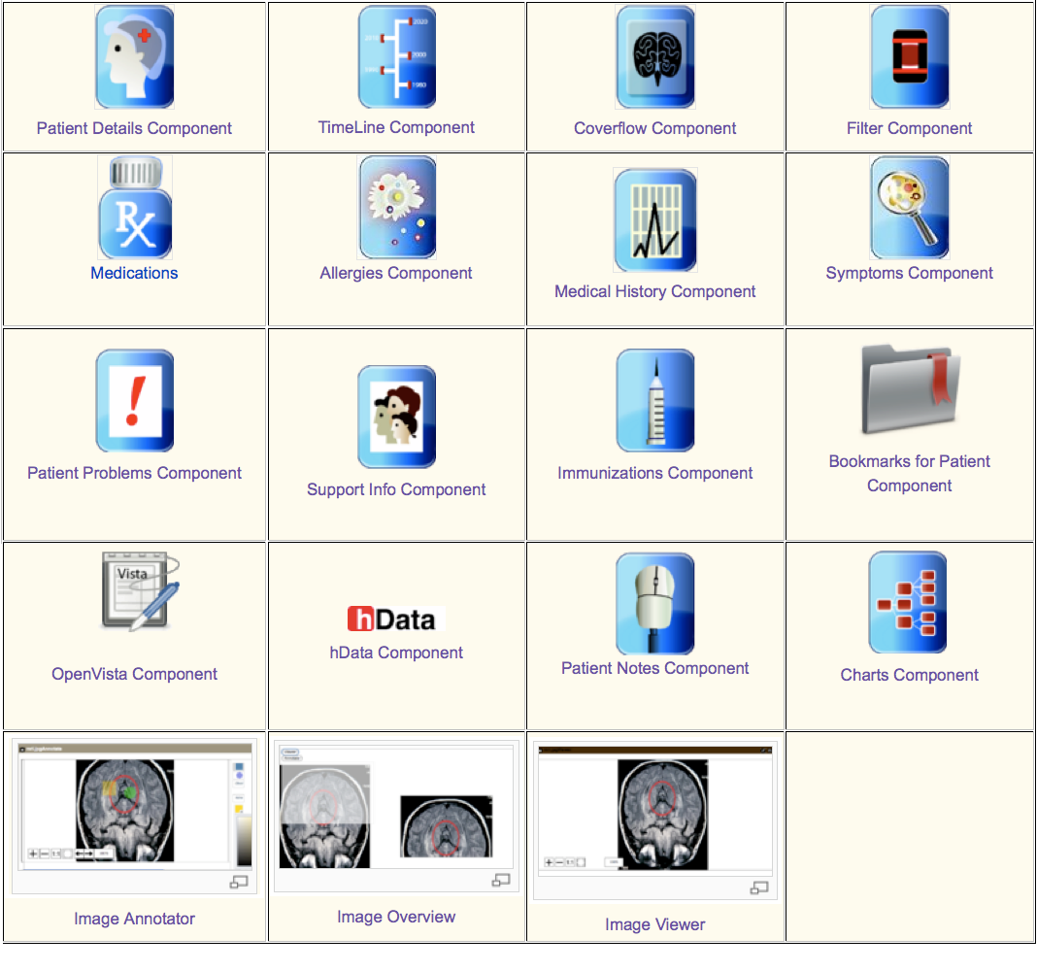
MedCafe Components

Slide 7
MedCafe Future Plans
Open sourcing of Code
Web presence
External medCafe server
Industry Reach out
White paper
Conference presentation
Document architecture
“Plugin Guide”

Slide 8
EHR: The Way Forward?
VA VistA Modernization
ACT-IAC Vista Modernization
Carnegie Mellon report recommending Open Source solution for VistA
Patient Centric approach
Clinical Groupware
ONC commits $60 million to 4 grants to solve EHR problems
Harvard SMART (Substitutable Medical Applications, Re-useable Technology) $15 million
“The approach could impact both the EHR industry…..(in) 1-3 years”¹
Clinical Groupware Consortium
New Data Delivery Platforms
iPad Apps, smart phone apps,..
Modularization Certification
HHS Certification process ("meaningful use of certified EHR technology”) for modular apps
CCHIT certification program for components of EHRs
¹http://www.thehealthcareblog.com/the_health_care_blog/2010/10/update-on-modular-ehr-technology-harvards-smart-research.html
Notes:
SMART: creating a “medical apps store” based on the iPhone/iPad model of substitutable applications running on a device or platform.
The approach could impact both the EHR industry and the federal regulatory and standards process, possibly within a relatively short period, i.e., 1-3 years, so we think it merits your attention.
ONC: Office of the National Coordinator for Health Information Technology

Slide 9
MedCafe : Why What We Did Matters!
Truly Modular EHR
Incorporating idea of “Substitutability”, allowing for Best of Breed
Leading edge prototype for Healthcare
Architecture arrived at with MITRE expertise / knowledge before rest of Healthcare
At the forefront of Healthcare IT
Ahead of any current implementation using this approach
Our budget: ~ 400k, SMART budget: 15 million
Scalable architecture
Prototype that shows viability of approach
iPad interaction via “Gestures”
Interfaces with OpenVista
As close to current VA repository as possible
Open source, business friendly license
Any vendor or organization can take code base and adapt/ enhance

